Slide 1
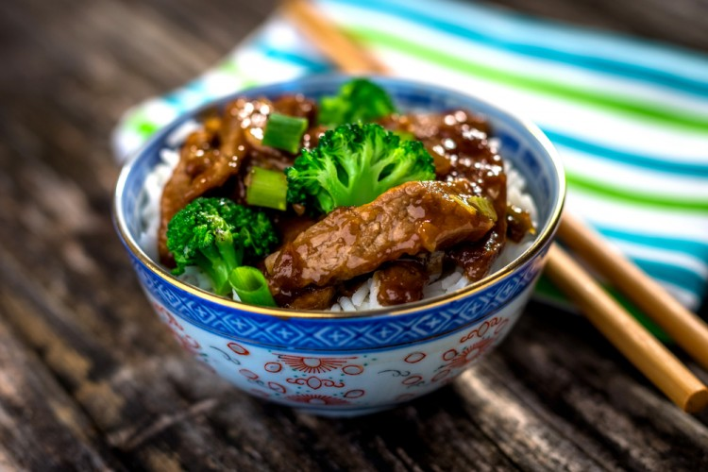
2
00.30
ingredients
- Flour: 1/2 cup
- meat gravy: cup
- Sugar: 2 large spoon
- Soy sauce: 2 large spoon
- Felipe meat: 500 grams (cube cutter)
- Ginger: 1/2 teaspoons (fresh and grilled)
- garlic: lobe (mashed)
- Broccoli: 3 cups (small flower section)
preparation method
In a deep bowl, mix flour with gravy, sugar, and soy sauce until sugar dissolves.
In a wide pan on a high fire, place the meat and my heart for about 5 minutes until it's brown, then add the gravy and soy mix and stir the ingredients well.
Add the ginger, broccoli, and garlic, and then leave the ingredients until boiling.
Keep the fire under control, and leave it for about 8 minutes until the gravy has condensed. Then place it in the plate of presentation, with hot feet and rice.
broccoli meat

Slide 2
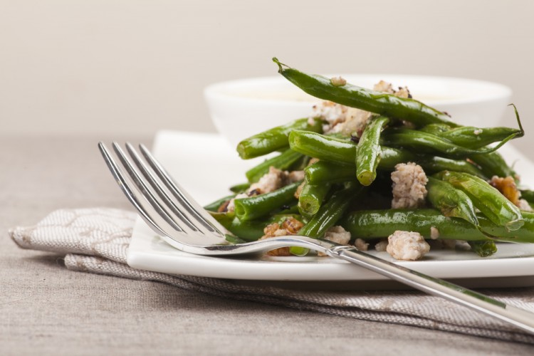
4
00.30
ingredients
- Green beans: 500 grams (laundry)
- Garlic powder: half a teaspoon
- onion powder: half a teaspoon
- salt: sprinkle
- Black pepper: spray
- lemon juice: two and a half large spoons
- Fita cheese: Half cup (muffled)
- Butter: small spoon
preparation method
Protect the oven at 180 degrees Celsius.
My belly is a butter-paper oven tray, then put in the beans with it, and add the butter and my heart the ingredients until it blends.
You wear onion powder, garlic powder, salt, black pepper, then my heart of ingredients.
Put the tray into the oven for about 20 minutes.
Place the beans in the application, then add the lemon juice, spread the feta cheese over and give my heart a little, and then offer it.
Green roasted bean

Slide 3
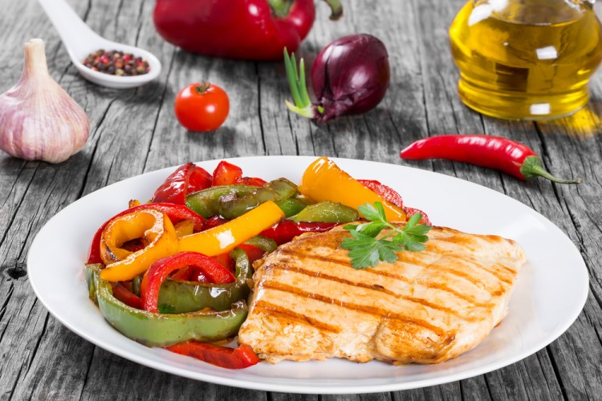
Chicken steak
ingredients
- Chicken breast: 2 chest (chiseled)
- Carrots: 1 pill (peeled and cut rings)
- Zucchini: 1 pill (rings)
- Tomato: 2 pills (rings)
- Onion: 1 pill (peeled and cut-off)
- Black pepper: small spoon
- salt: small spoon
- Origano: A little spoon
- vegetable oil: large spoon
- Water: half a cup
preparation method
Wear the chickens half as much salt, black pepper and origano and leave them aside.
Mix carrots, zucchini, potatoes, tomatoes, and onions, with the rest of the salt, pepper, and origano and put them in an oven tray that is fat with little oil.
Add chickens and water, and then cover the tray with tin paper.
Protect the oven at 180 degrees Celsius.
Insert the tray into the oven for about an hour until it's fully ripe, and then her feet are hot.
2
00.40

Slide 4
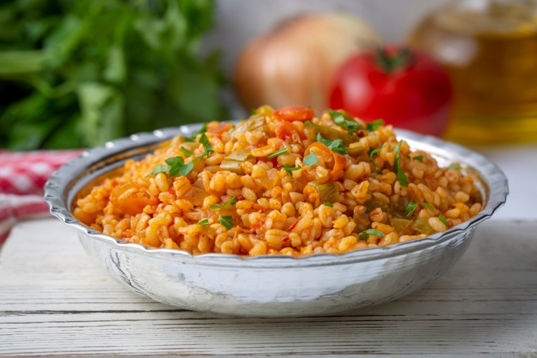
2
00.30
bulgur tomato and onion
ingredients
- Bergel: Cup (rough)
- Onion: 1 pill (soft chopped)
- Green onions: 2 sticks (minced)
- Tomato: 2 pills (peeled and chopped)
- Olive oil: large spoon
- salt: small spoon
- Black pepper: spray
- tomato paste: 2 large spoon
- Water: one cup and one third
preparation method
Soak the bulgur with water for 25 minutes.
Put the olive oil in a pot on fire, and add the onion, the green onion, and my heart until it melts.
Add the chopped tomatoes, stir until ripe, and then add tomato paste, salt sprinkle, black pepper, and stir the ingredients well.
Add the bulgur and my heart a little, then pour the water and leave the pot on fire until the bulgur is ripe, then his feet hot.

